Slide 1
PTMTorrent: A Dataset for Mining Open-source Pre-Trained Model Packages
Nicholas Synovic* Purvish Jajal Taylor R. Schorlemmer
Arav Tewari Bhavesh Pareek
George K. Thiruvathukal James C. Davis
Wenxin Jiang*
Notes:
Hi, I am Jamie Davis from Purdue University.
I am glad here to present a paper on behalf of my student Wenxin Jiang whose plane was delayed.
Our work is in collaboration with Loyola University Chicago. We thank Cisco, Google, and the US NSF for their support.
Our work introduces the PTMTorrent dataset which can be used for mining open-source pre-trained model packages.
(Click)

Slide 2
Contributions
PTMTorrent 15,913 PTM packages from 5 model hubs
Schema (Semi-)unified data schema for cross-hub mining
Directions
Mining PTMs
Mining PTM supply chains
Mining tools
Notes:
Our contributions are:
First, we published a dataset called PTMTorrent. It includes 15K PTM packages from 5 model hubs for future analysis
Second, we created a uniform data schema for cross-hub mining
Third, we outline several research directions, including opportunities on mining PTMs, on mining the PTM supply chain, and on mining tools..
(Click)

Slide 3
Background and Motivation
Notes:
Then I will talk about the background and motivation for our dataset
(Click)

Slide 4
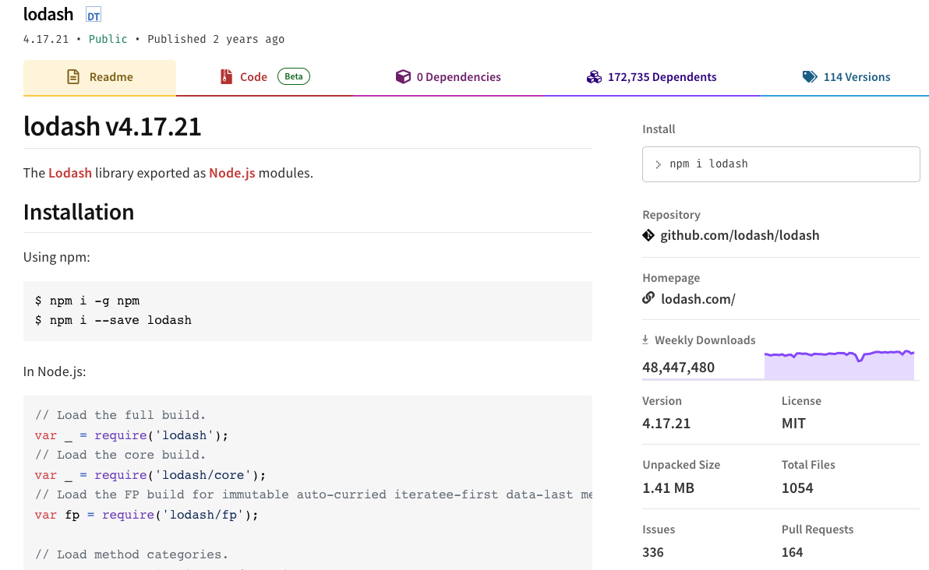
Traditional Software Packages
Notes:
We’re probably all familiar with traditional software packages and the registries that hold them.
For example, here is the LODASH package hosted by the NPM registry for JavaScript software.

Slide 5
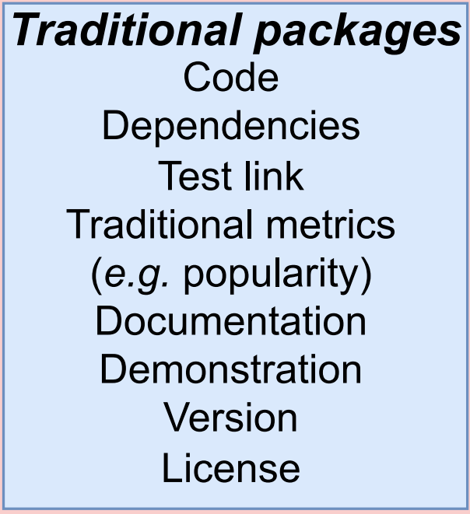
Traditional Software Packages: Components
Notes:
Here are some components of a traditional package.

Slide 6
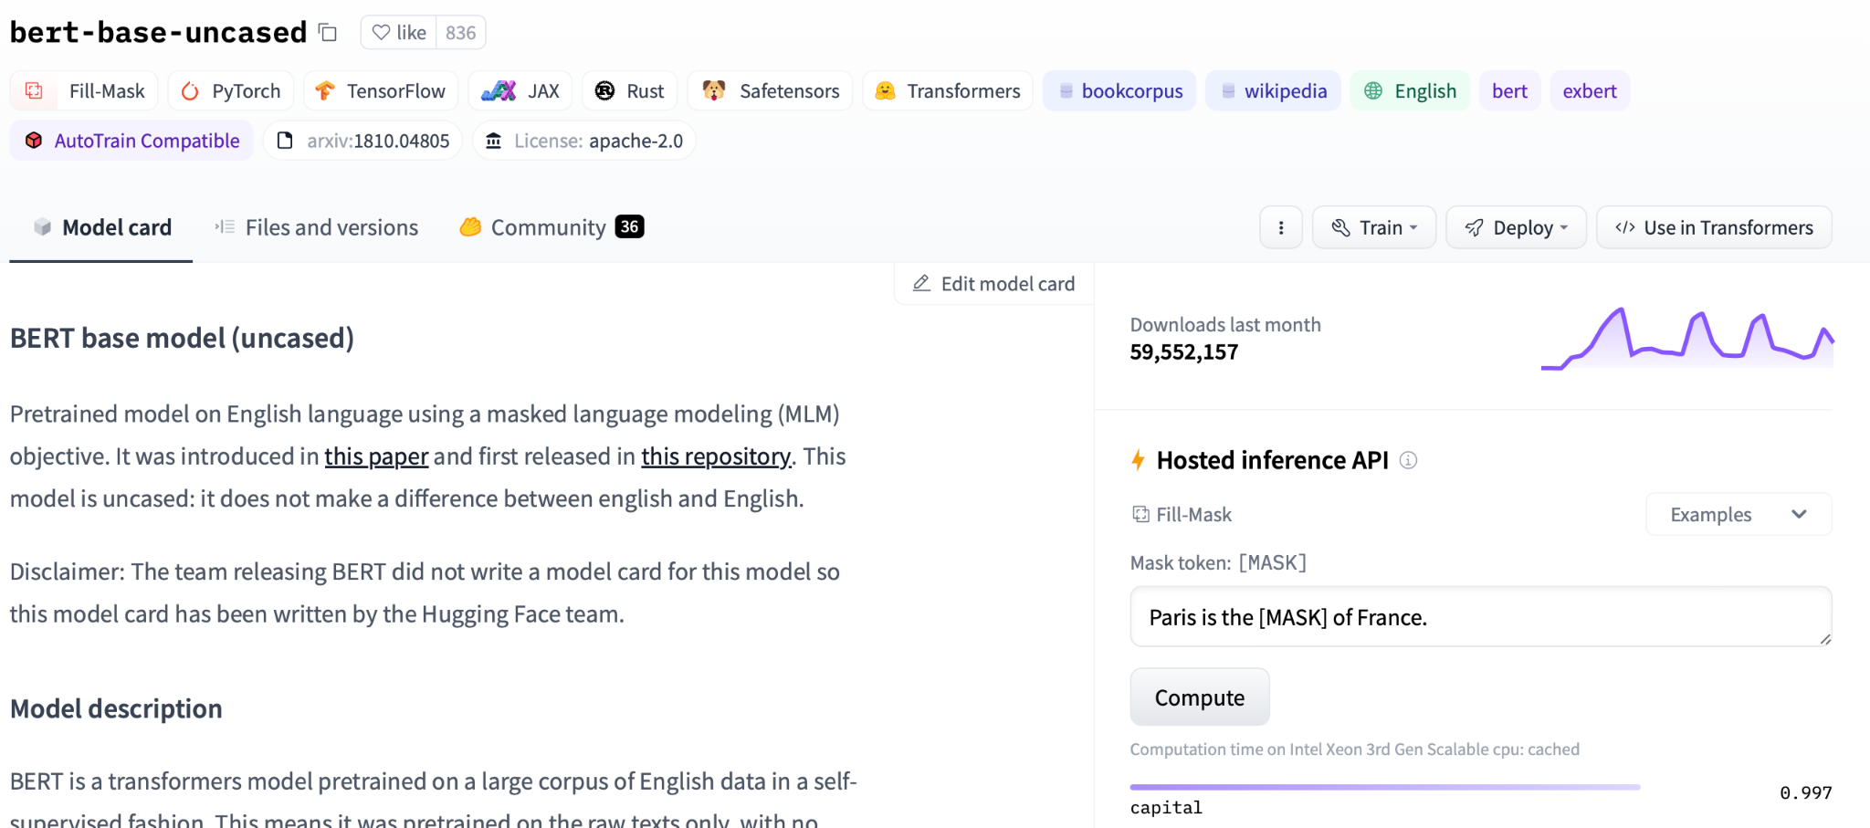
New (Pre-Trained Model) Software Packages
Notes:
ML Models (especially Deep Neural Networks) are also being packaged for re-use. There are also registries that hold these!
For example, here is the BERT-BASE-UNCASED package hosted by the HuggingFace registry for DL software.

Slide 7
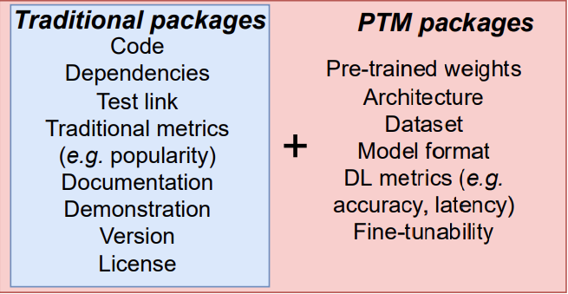
What’s in a Pre-trained Model Package (PTM)?
Package components:
Notes:
A PTM package is similar to traditional packages,
But it can include some DL-specific parts.
(Click)
E.g. pre-trained weights, training datasets, DL-specific metrics
Due to the different reuse scenarios of PTM packages (e.g. complicated model selection process, and costly evaluation loop)
The characteristics of PTM packages are different from traditional software packages
And few studies have explored this topic yet
(Click)
There are several model hubs/registries that provide PTM packages
HF, Pytorch hub, ONNX model zoo, modelhub

Slide 8
Motivation for a new dataset
PTMs are distributed in many places
Accessibility issues (git-lfs, rate limits, etc.)
Scientific replicability → Long-term data
→ PTMTorrent: PTM packages from many model hubs
Notes:
Now you might ask: “if all the PTM packages are available on these model hubs, why do we need a new dataset?”
Here are three reasons that we created a new dataset:
(click x 3)
The PTM are distributed in many places and the model hubs provide different APIs to facilitate model reuse. There is no one-stop shop to compare PTMs from different model hubs.
PTMs can be really big! Some model hubs, they rate limits on accessing PTMs to prevent server overloads and service disruptions. This makes it harder to access a large amount of PTMs.
We would like to keep long-term data to support the scientific replicability of our work
(click)
We want researchers to have easy access to PTM packages.

Slide 9
PTMTorrent
Notes:
Let me introduce the PTMTorrent dataset

Slide 10
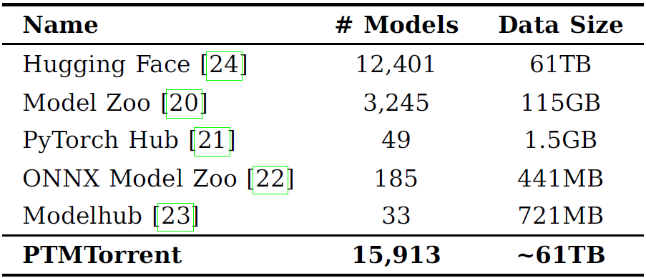
Data Collection
Notes:
Here is our data collection workflow:
(Click)
We identified several model registries, some of which have been covered in prior study on PTM supply chain
(Click)
We built tooling to obtain PTM packages from each model registry and map to the corresponding github repositories.
(Click)
We extracted metadata from each PTM package and induced a unified data scheme
(Click)
The result is a dataset of 15,913 PTM packages. HuggingFace is a sample; the rest is “all models at time of study”.
The dataset is 61TB total. This is because it includes all the available pre-trained weights.

Slide 11
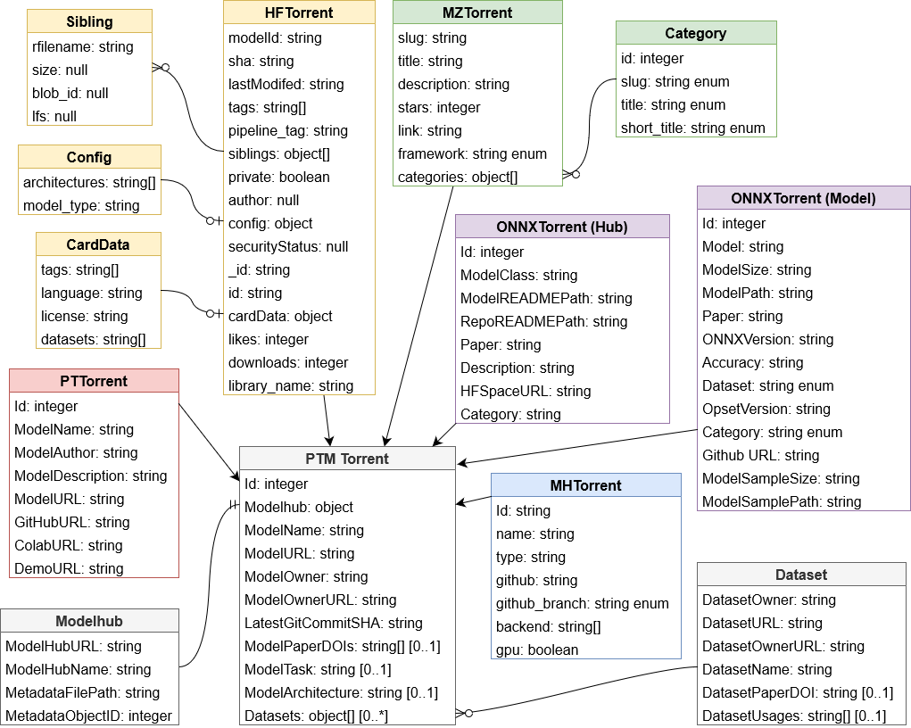
A peek at the data schema
Notes:
Common attributes in the grey boxes (along the bottom), plus registry-specific data (color coded)

Slide 12
Usage examples
Measuring model registries
Mining risks in Hugging Face (ICSE’23)
Dependencies between model architectures and datasets
PTM documentation
GPG Commit signing
Mining model discrepancies and maintainer’s reach (SCORED’22)
Applying MSR Tool
We applied our PRIME tool to get software process metrics
Demo on GitHub
Notes:
Then I will show some usage examples for our dataset.
(click)
We used the dataset to measure the risk mitigation of HF model registry. This includes the measurement of dependencies, documentation, and GPG commit signing
We also used the metadata to identify model discrepancies and maintainers’ reach graph
(click)
Moreover, researchers can also apply MSR tools on our dataset.
PRIME is a tool which can be used to analyze software process metrics. We demonstrate the usage of the tool which is available on Github.
(click)

Slide 13
Three directions for research
Mine the PTMs
Mine the PTM supply chain
Mining tools → Improve PTM registries
Notes:
In the time remaining, I’ll sketch a few directions for research with PTMTorrent:
Mine the PTMs. Prior work has mined many traditional software packages in a million ways. Now we can do it on PTMs! We can look at topics including PTM implementation patterns, dependencies, vulnerabilities, and knowledge transfer. We can understand both the PTMs themselves, and the comparison to traditional software. Much is unknown.
Mine the PTM supply chain. Our dataset includes both traditional dependencies (e.g. Python code in data pipelines) and PTM dependencies (e.g. neural network architectural reuse). You can follow a PTM upstream and downstream to see the supply chain and how new PTMs are developed by composing existing ones.
Mining tools. Our paper at ICSE interviewed engineers who use PTMs. Their most common complaint was that it is hard to obtain metrics associated with PTMs. Can we develop mining tools to help them and to make a big impact on improving PTM registries?

Slide 14
In summary…
A many-hub dataset of PTM packages
Let’s use it!
Contact: jiang784@purdue.edu
Website: wenxin-jiang.github.io
https://github.com/SoftwareSystemsLaboratory/PTMTorrent/
Notes:
In conclusion,
PTMTorrent is the first many-hub dataset of PTM packages
We invite the community to explore and leverage our dataset as a valuable resource for their own investigation.
That's all for my talk!
The mining code is available on GitHub.
The dataset is available for download through a Globus share hosted at Purdue University.
Thank you very much for your attention!

Slide 15
Bonus slides
‹#›

Slide 16
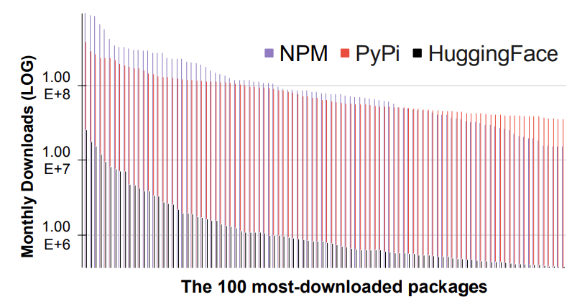
Pre-trained Model Hub (Registry)
What is it?
Modeled on traditional software package registries
→ Enable reuse-driven DNN engineering
Compared to traditional package registries
1,000,000+
Notes:
DL Model Registries:
Goal: help engineers better reuse these costly artifacts
(click)
Compared to traditional package registries:
HuggingFace is the largest model hub. It mainly provides language models. In August 2022, it had over sixty thousand public PTMs. Now it has over 200 thousand PTMs.
(click)
The downloaded rates of HF are comparable to the popular packages in npm and Pypi which are two of the most traditional software package registries.
(click) The most popular PTMs has over 10 million monthly downloads.

Slide 17
PTMTorrent - Originality
Originality
GHTorrent, TravisTorrent, and RTPTorrent have captured open-source packages
PTMTorrent captures open-source PTM packages

Slide 18
Model Hub – What They Are
What is a Model Hub?
Collection of PTMs, generally for a diverse set of tasks. A model hub might contain PTMs for image classification AND object detection.
Model Zoo
3
Notes:
Description taken from https://wenxin-jiang.github.io/files/publications/MontesPeerapatanapokinSchultzGuoJiangDavis-ModelZoo-FSE22IVR-slides.pptx

Slide 19
PTMTorrent - First Many-Hub Dataset
PTMTorrent is the first dataset to provide access to PTM repositories from many model hubs
Model Zoos take well-known deep neural network architectures, often from research papers, and implement them.
Model Hub | # of Models Captured | Size of Data Captured
 | 12,401 | 61TB
 | 3,245 | 115GB
 | 49 | 1.5GB
 | 185 | 441MB
 | 33 | 721MB
PTMTorrent | 15,913 | ~61TB
‹#›

Slide 20
PTMTorrent - Data Schema
‹#›

Slide 21
PTMTorrent - Maintainability and Extensibility
Maintainability and Extensibility
Model Hubs are growing in size
E.g. Hugging Face had 63,182 public PTMs on August 2022, and now 124,427 on February
Biannual Updates are to be expected
New model hubs can be incorporated into PTMTorrent so long as it fits the Data Schema
3

Slide 22
PTMTorrent - Limitations
Limitations
Biased towards the top 10% of most downloaded Hugging Face models
Does not include all model hubs
Does not include models from model hubs that lack version control
Non-standardization of granularity
3

Slide 23
Directions for research
Extending the PTMTorrent dataset
Non-standardized granularity
Future directions:
Supporting future PTM supply chain analysis
Expanding PTM model registry analysis
Furthering the state of mining tool development
Notes:
We also identified several limitations and directions based on our dataset:
(click)
The first limitation is that we only included 5 model hubs in the dataset. However, there are more model registries. For example, Caffe model zoo, Nvidia Jetson model zoo, Determined AI, OpenVINO model zoo.
We are planning to include more model hubs and model zoos in our next version.
(click)
The second limitation is the non-standardized granularity of our dataset. Different model hubs provided different granularity of metadata which makes it hard to use a generalized data schema for all of the data.
(click)
We suggest three future directions for researchers:
Our dataset include dependencies of upstream and downstream PTMs which can be utilized to analyze the PTM supply chain
The data can also be used to improve the infrastructure of PTM model registries
We also suggest researchers to further the state of mining tool development to PTM packages.
(click)

Slide 24
PTMTorrent - Links
GitHub
Globus
3

Slide 25
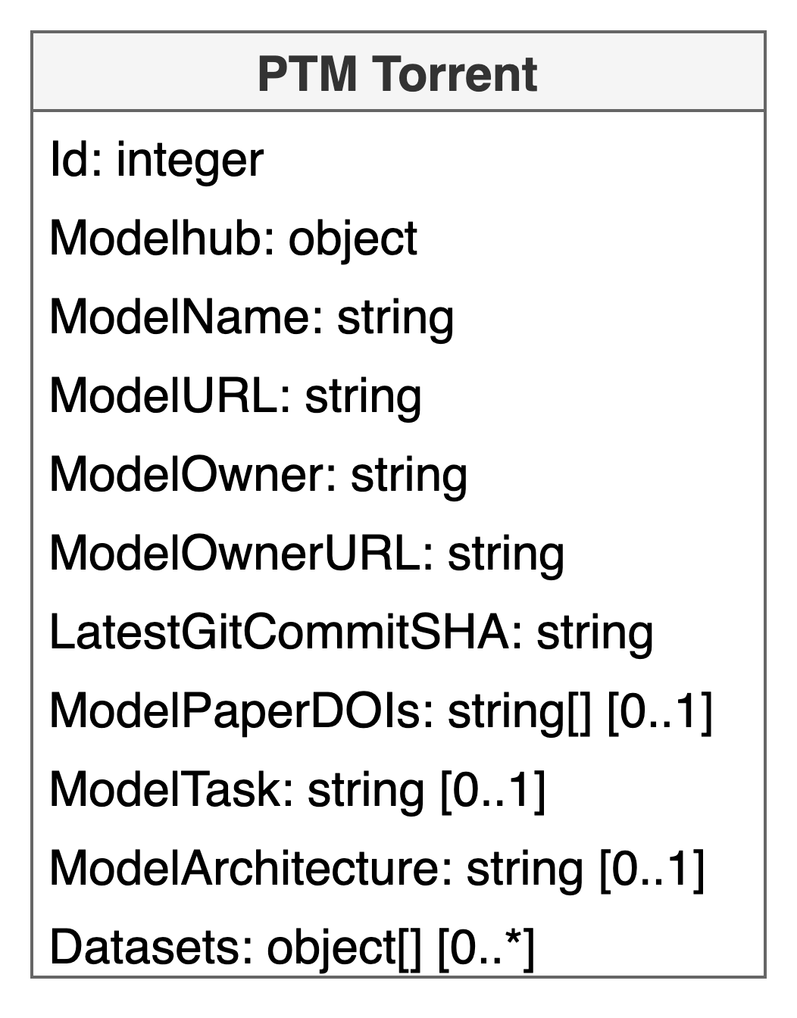
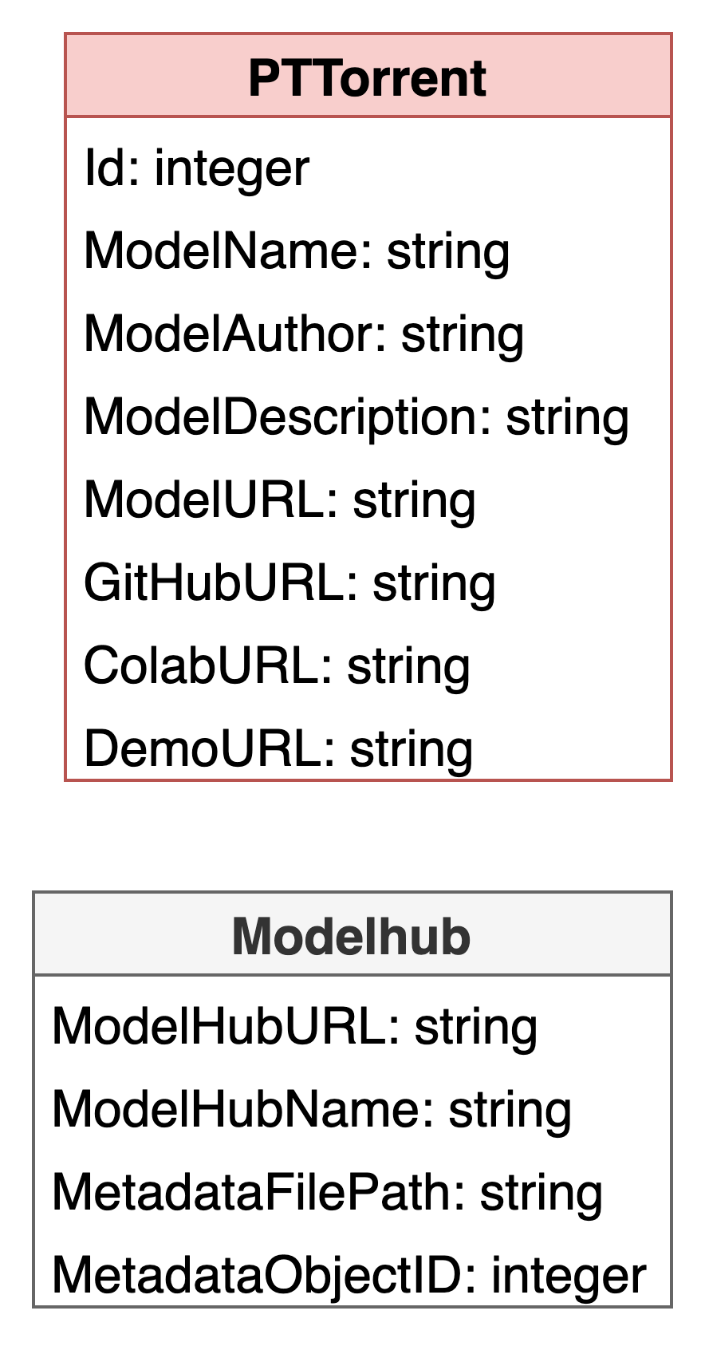
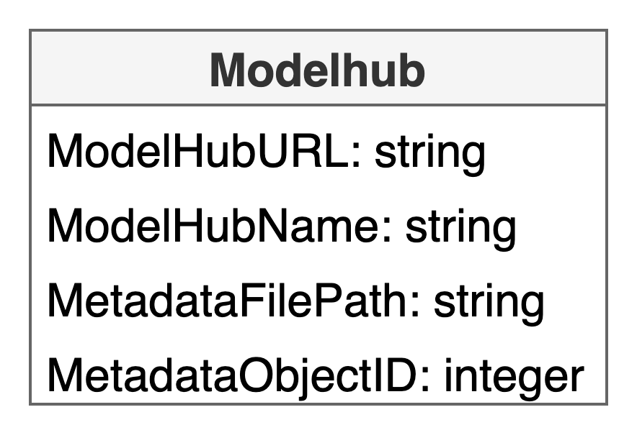
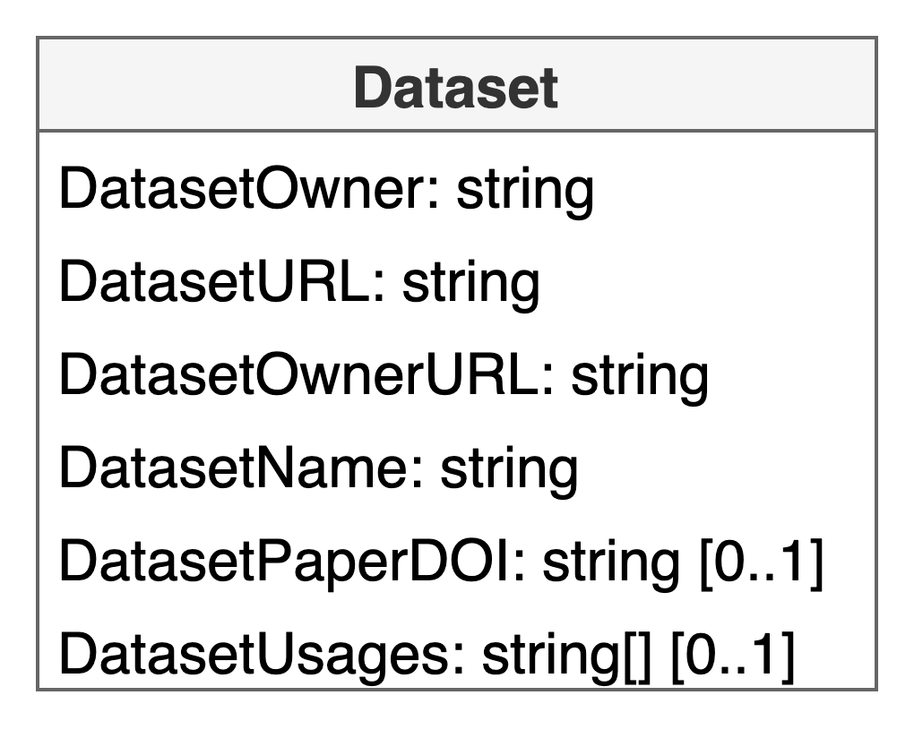
Data Schema

